Slide 1
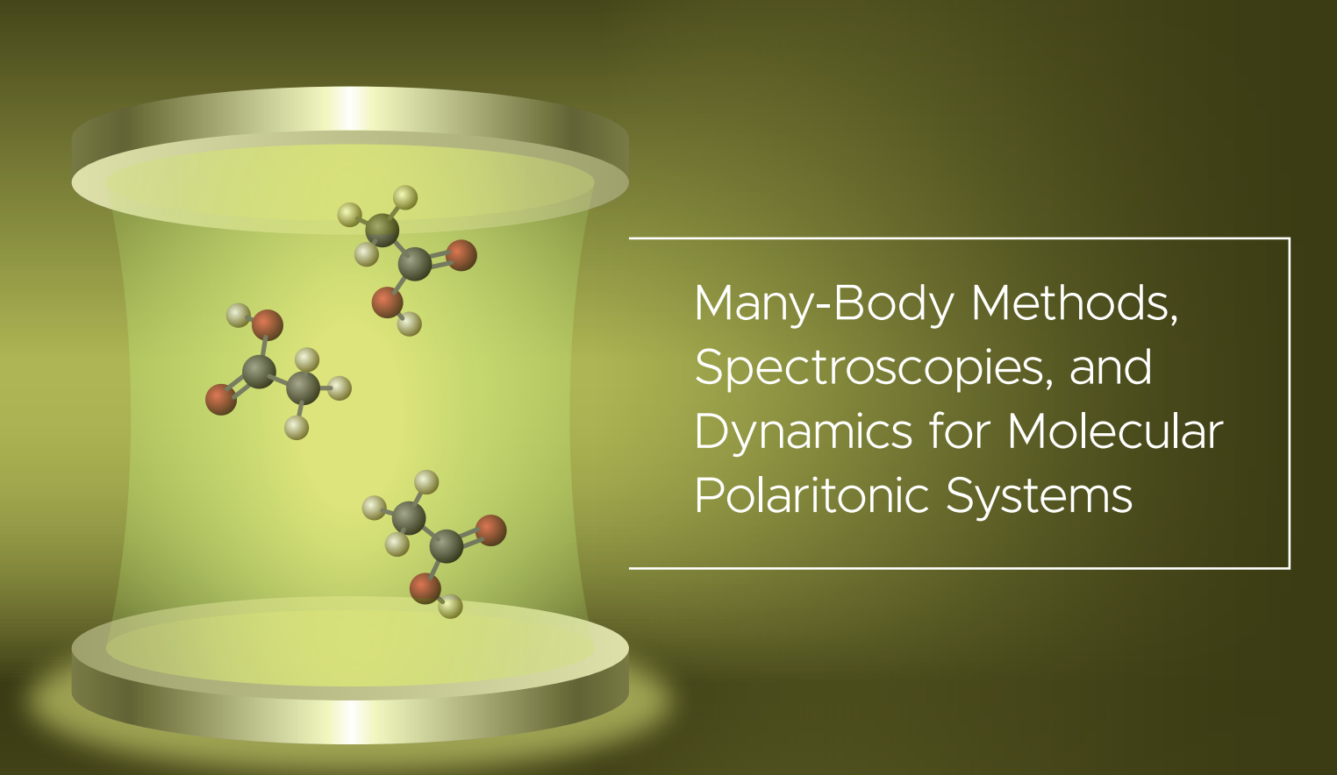
Jay Foley, Associate Professor
UNC Charlotte Department of Chemistry
https://foleylab.github.io/

Slide 2
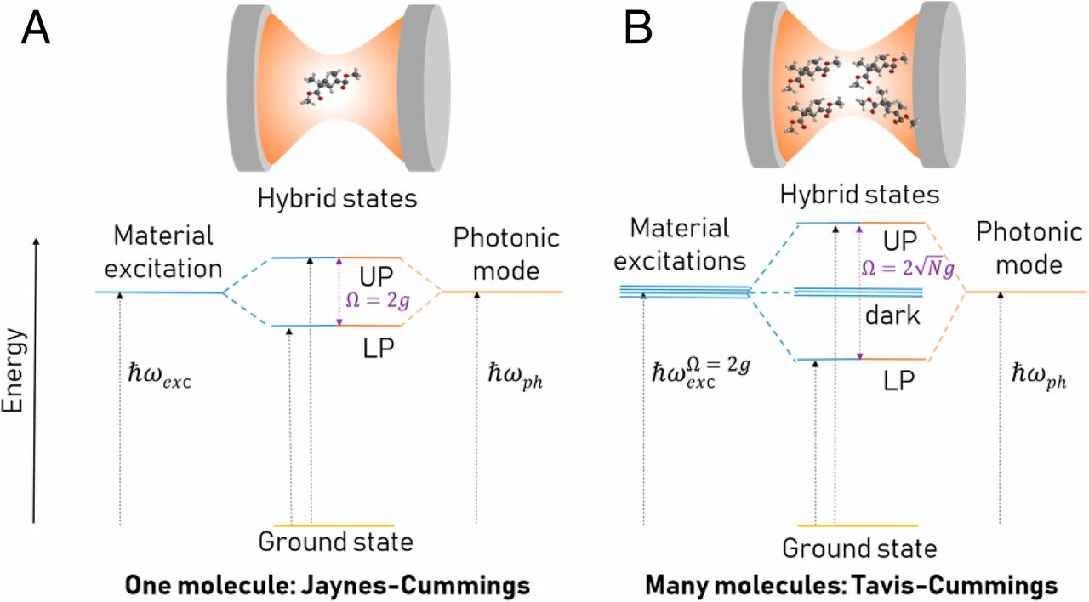
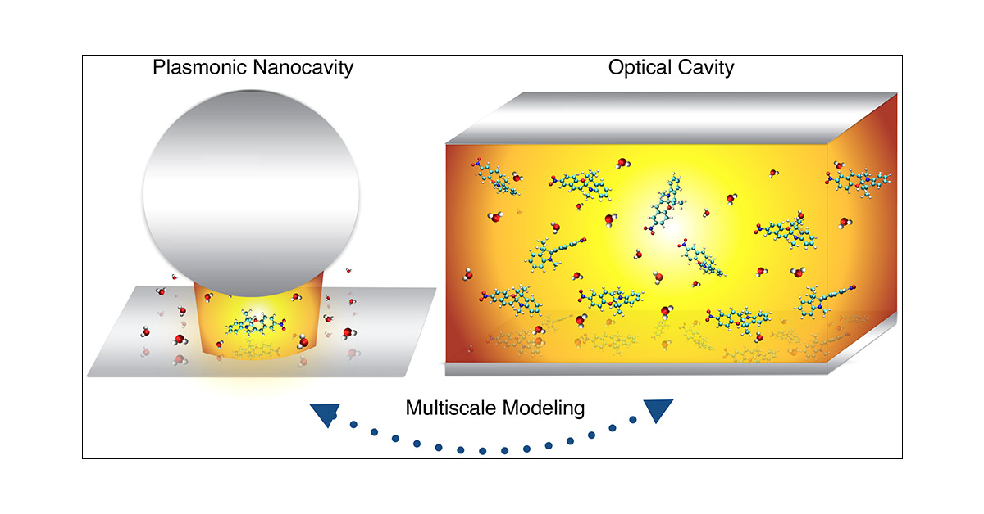
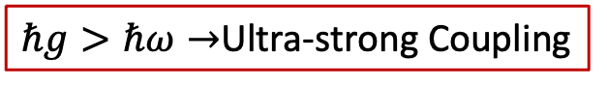
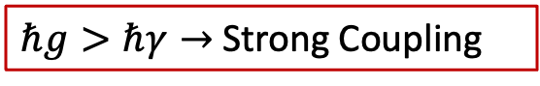
Ingredients of polaritonic chemistry Strong interaction between light and molecular excitations
$ℏg>ℏγ→$Strong Coupling
$ℏg>ℏω→$Ultra-strong Coupling
Interaction compared to energy dissipation
Interaction compared to excitation energies
Fregoni, Garcia-Vidal, Feist,
ACS Photonics 2022, 9, 4, 1096–1107
Yuen-Zhou and Menon, PNAS 2019, 116, 5214-5216

Slide 3
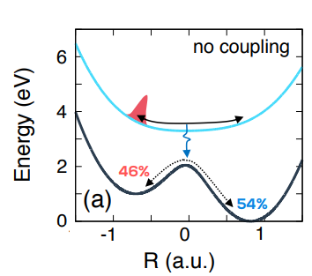
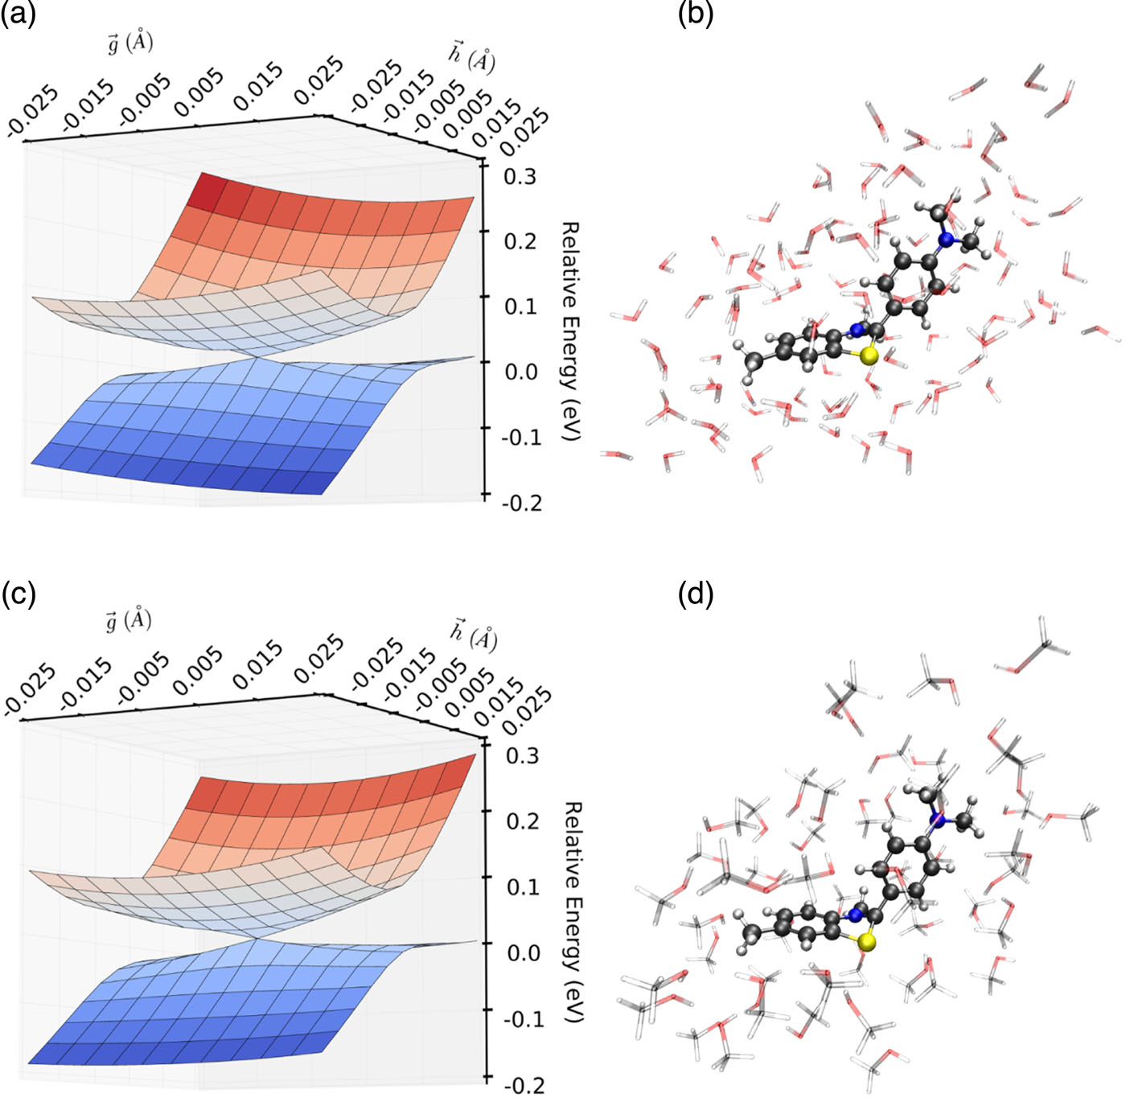
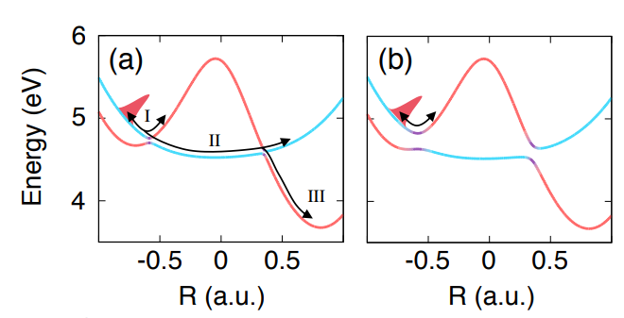
Quantum chemistry for polaritonic surfaces and couplings
J. Chem. Phys.. 2017;147(9) doi:10.1063/1.5000476
Mandal and Huo, J. Phys. Chem. Lett., 10, 5519-5529 (2019)

Slide 4
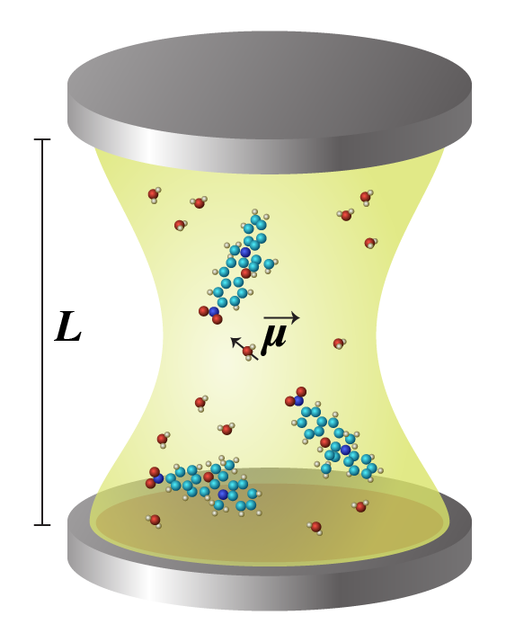
Pauli-Fierz Hamiltonian
ab initio molecular Hamiltonian
Photonic Hamiltonian
Bilinear molecule-photon coupling
Quadradic dipole self energy

Slide 5
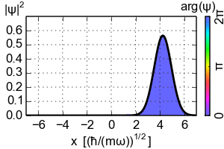

Coherent state transformation
$$†$$
Coherent state
”It’s just a state that, no matter what happens in life, can’t be annihilated”
Koch and co-workers, PRX 10, 041043 (2020)
”It’s just a state that, no matter what happens in life, never spreads”
Foley, McTague, DePrince, Chem Phys Rev, 4, 041301 (2023)

Slide 6
Coherent state transformation and solution to QED-HF
$$†$$
Coherent state

Slide 7
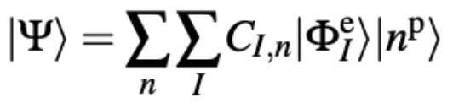
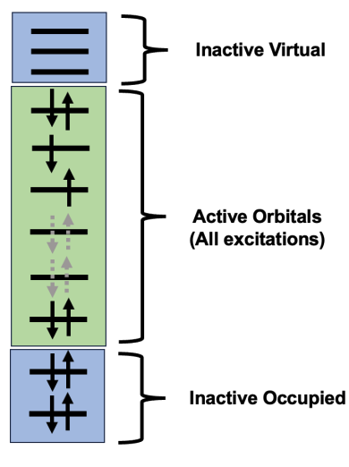
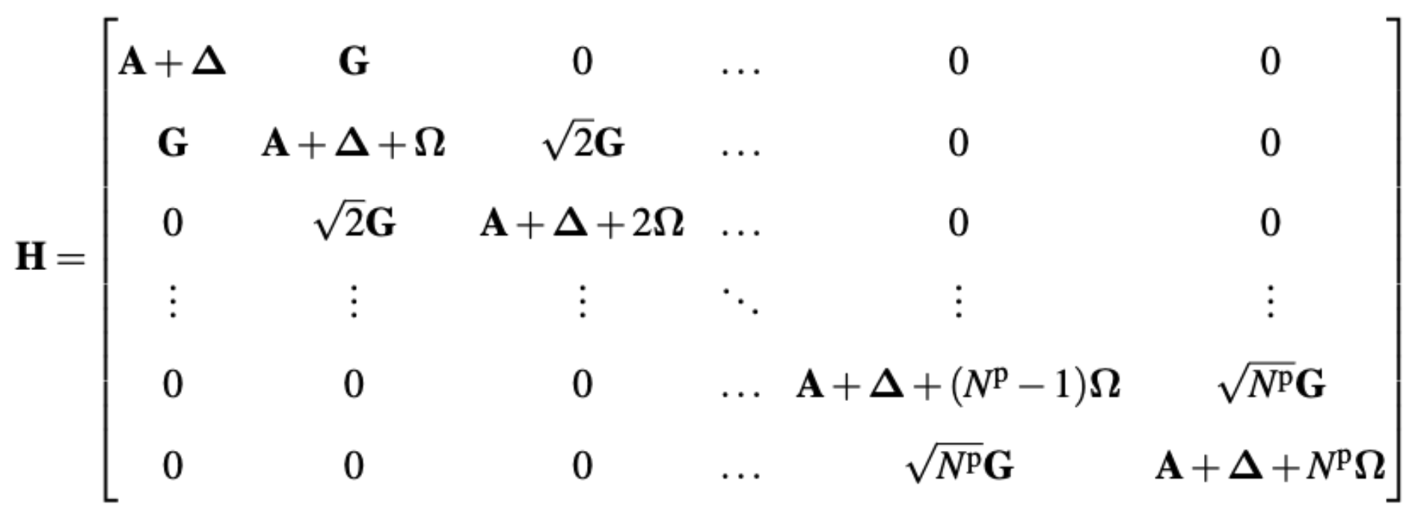
QED-CI for multiple polaritonic states
The CI space can be FCI, truncated CI, or CASCI

Slide 8
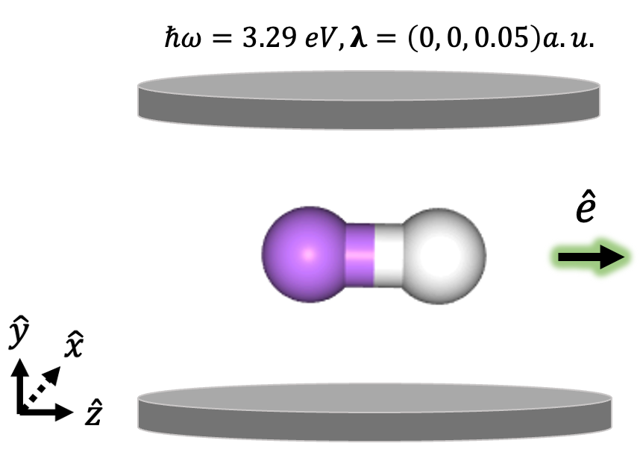
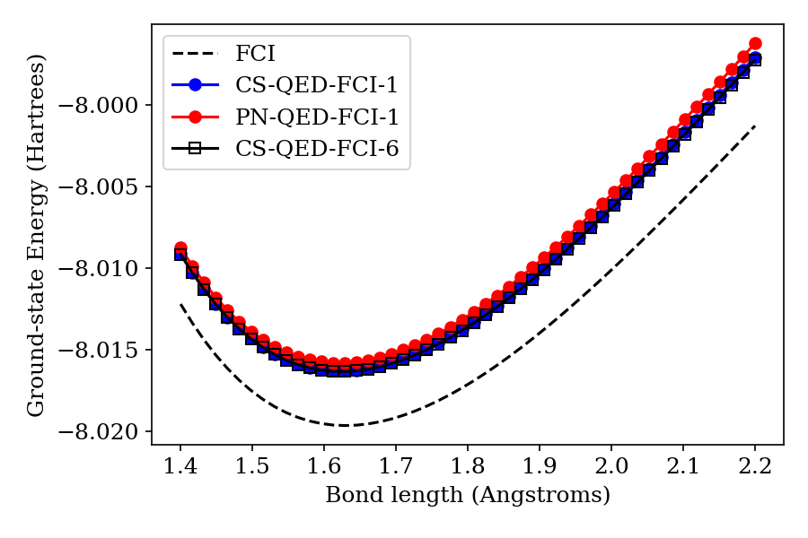
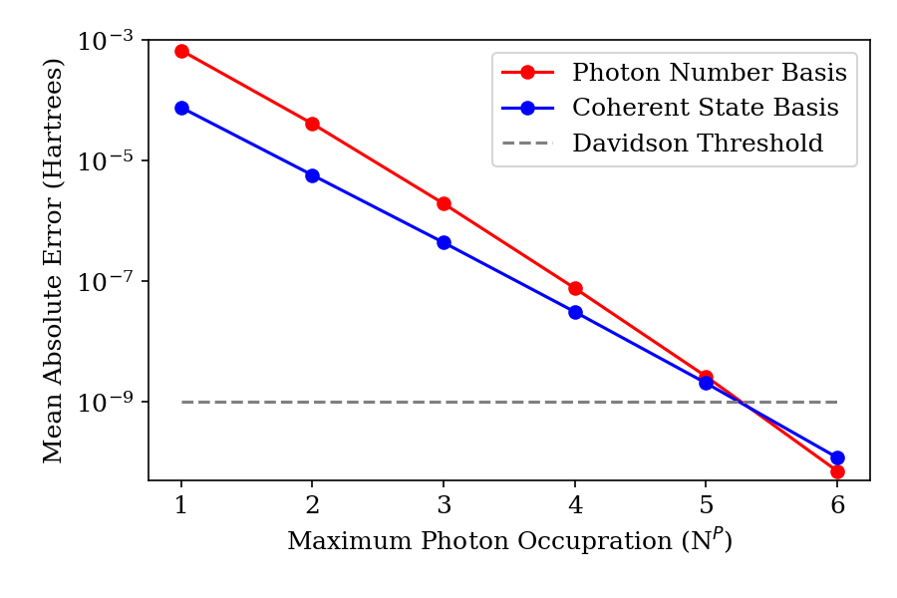
QED-FCI in Coherent State vs Photon Number State – LiH/6-311G
Vu, Mejia-Rodriguez, Bauman, Panyala, Mutlu, Govind, Foley, Under Revision at JCTC, Chemrxiv: 10.26434/chemrxiv-2023-kbhcv

Slide 9
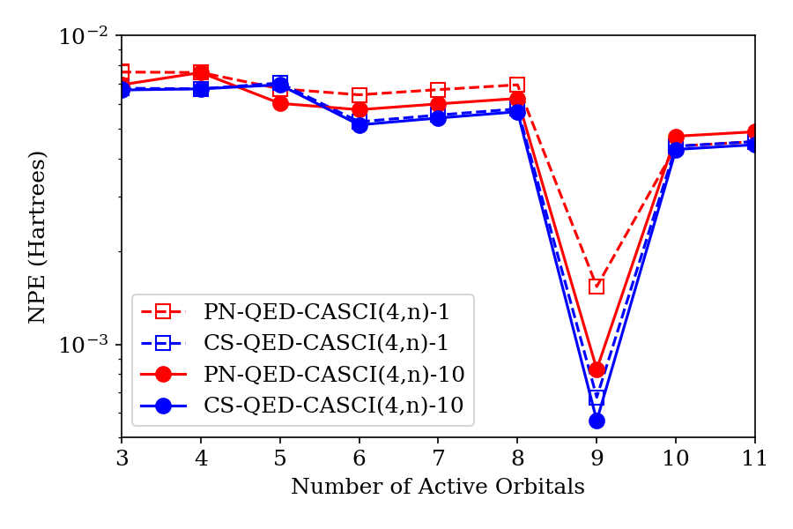
QED-FCI in Coherent State vs Photon Number State – LiH/6-311G
Vu, Mejia-Rodriguez, Bauman, Panyala, Mutlu, Govind, Foley, Under Revision at JCTC, Chemrxiv: 10.26434/chemrxiv-2023-kbhcv

Slide 10
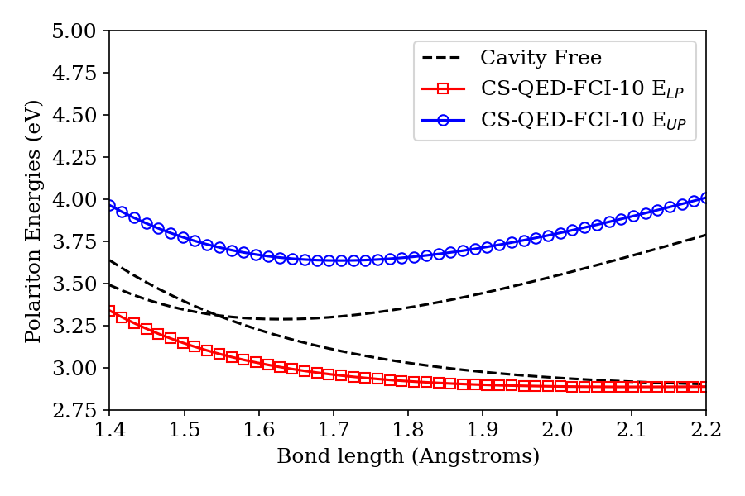
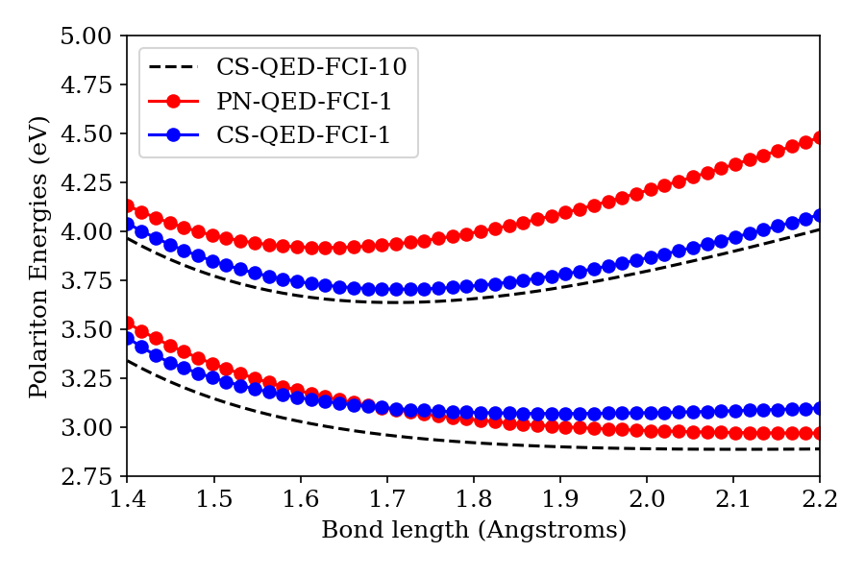
QED-FCI in Coherent State vs Photon Number State
Vu, Mejia-Rodriguez, Bauman, Panyala, Mutlu, Govind, Foley, Under Revision at JCTC, Chemrxiv: 10.26434/chemrxiv-2023-kbhcv

Slide 11
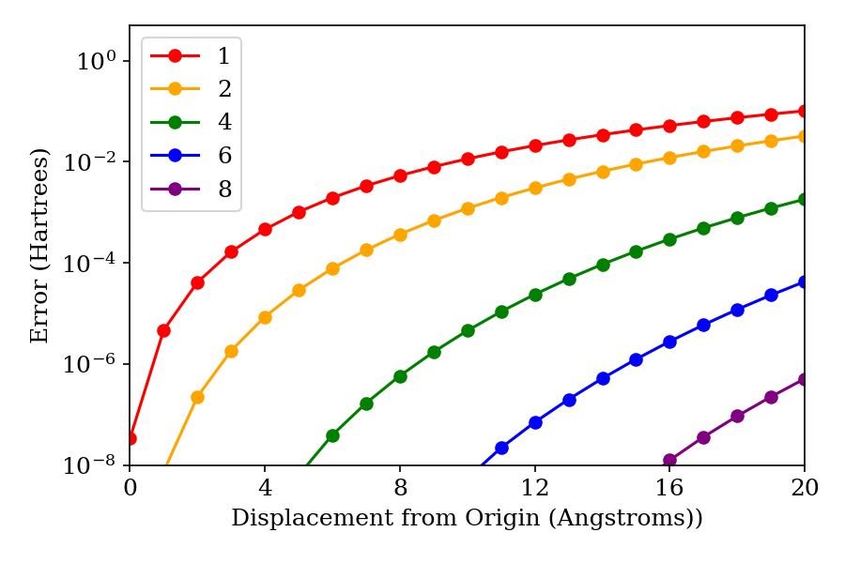
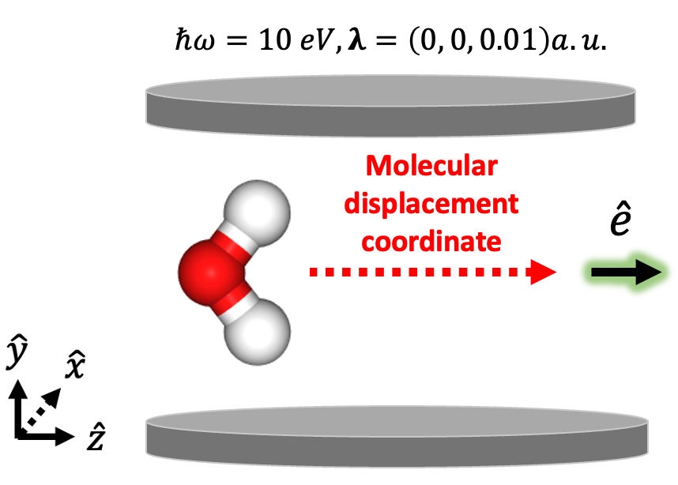
QED-FCI in Coherent State vs Photon Number State
Vu, Mejia-Rodriguez, Bauman, Panyala, Mutlu, Govind, Foley, Under Revision at JCTC, Chemrxiv: 10.26434/chemrxiv-2023-kbhcv

Slide 12
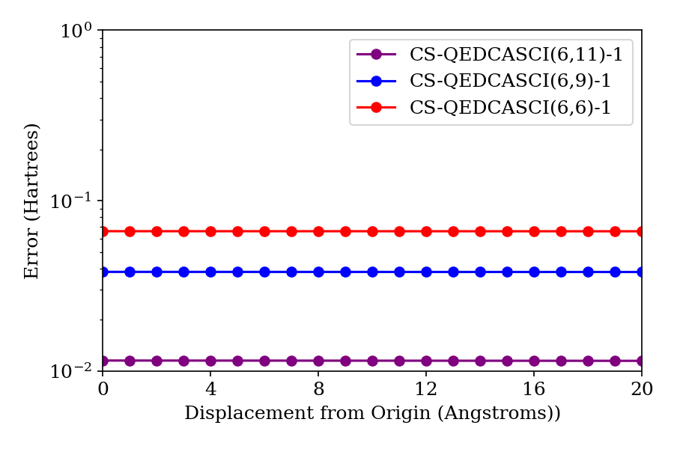
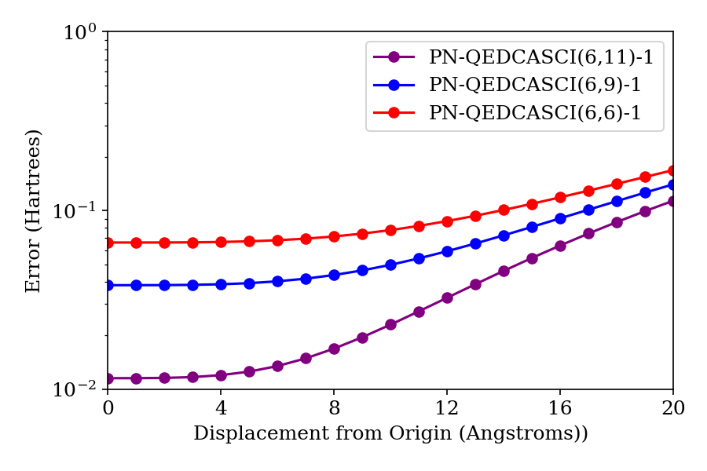
QED-CASCI in Coherent State vs Photon Number State
Vu, Mejia-Rodriguez, Bauman, Panyala, Mutlu, Govind, Foley, Under Revision at JCTC, Chemrxiv: 10.26434/chemrxiv-2023-kbhcv

Slide 13

QED-FCI in Coherent State vs Photon Number State
Vu, Mejia-Rodriguez, Bauman, Panyala, Mutlu, Govind, Foley, Under Revision at JCTC, Chemrxiv: 10.26434/chemrxiv-2023-kbhcv

Slide 14
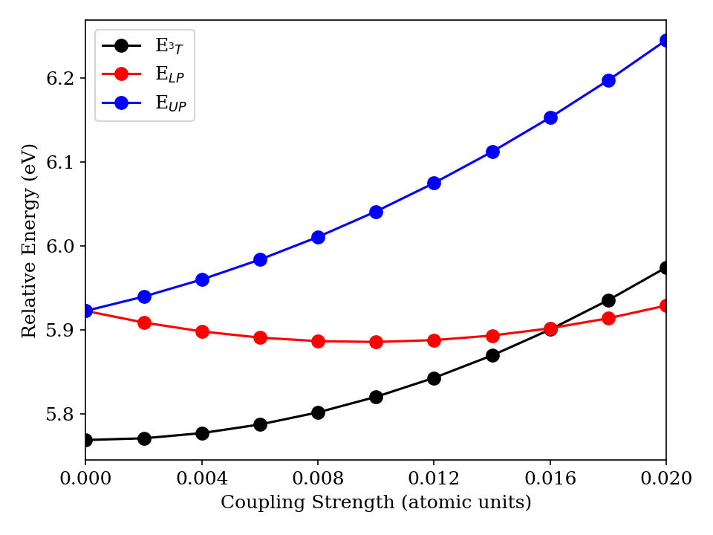
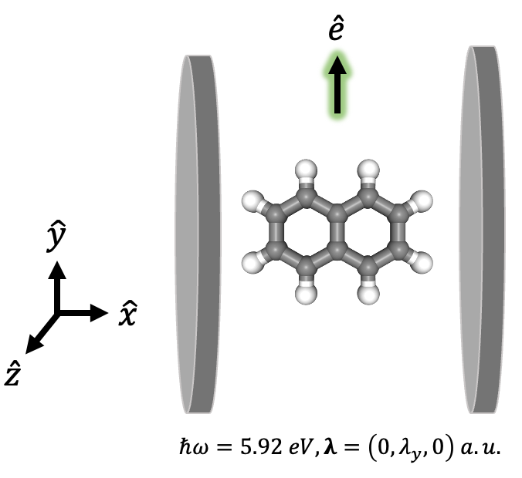
QED-FCI in Coherent-state vs Photon Number State basis
5 roots for a (12,12) active space with 100 photon states takes < 4 hours in our reference implementation!
Vu, Mejia-Rodriguez, Bauman, Panyala, Mutlu, Govind, Foley, Under Revision at JCTC, Chemrxiv: 10.26434/chemrxiv-2023-kbhcv

Slide 15



Reference implementations for QED-HF, QED-CIS-1 available in Psi4Numpy repo; QED-CIS Prism, QED-CASCI, QED-FCI available in group repos
Psi4Education Module -> MolSSI-MAPOL-Charlotte Workshop
Tutorials for QED-HF and QED-CIS Prism available
Production implementations in EXACHEM coming soon
High-order response, (non)adiabatic forces from automatic differentiation within 3 years

Slide 16

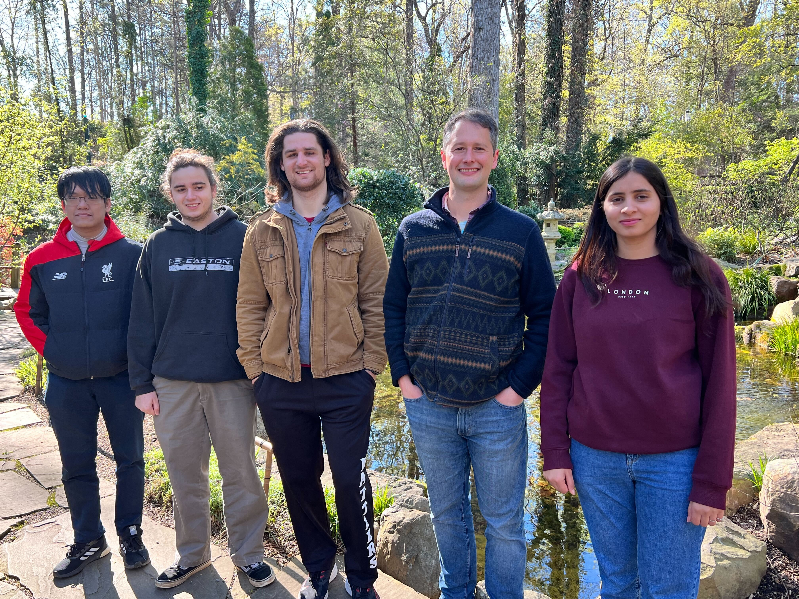
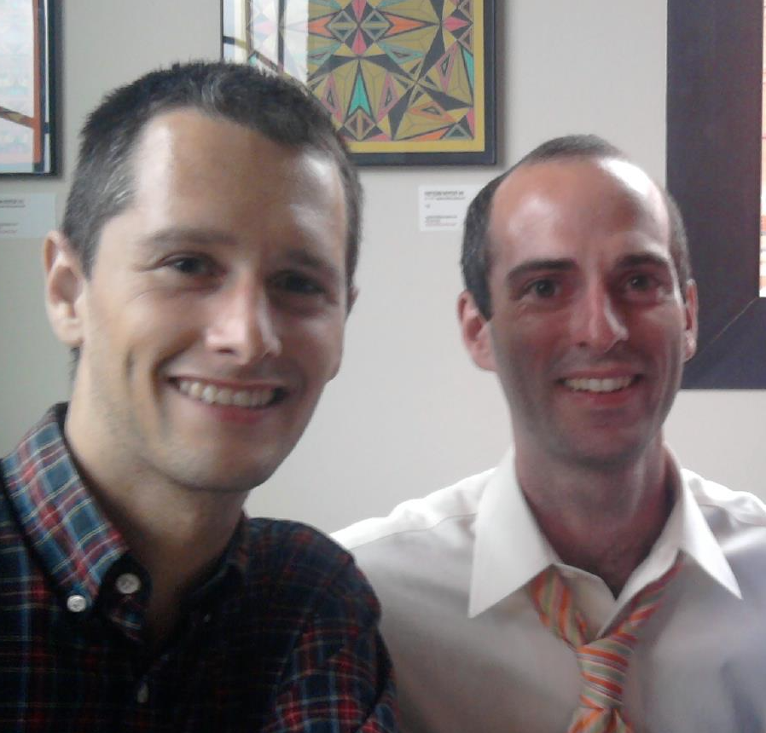




Nam Vu, Peyton Roden, Lane Tolley, Jay, Ruby Manderna

